Slide 1

eCommerce Sales Forecasting
Author: Dominique Grimes
Date: July 21, 2024

Slide 2
Business Problem
Businesses need a way to anticipate risks, proactively support client demands, and have data to supplement making certain business decisions.

Slide 3
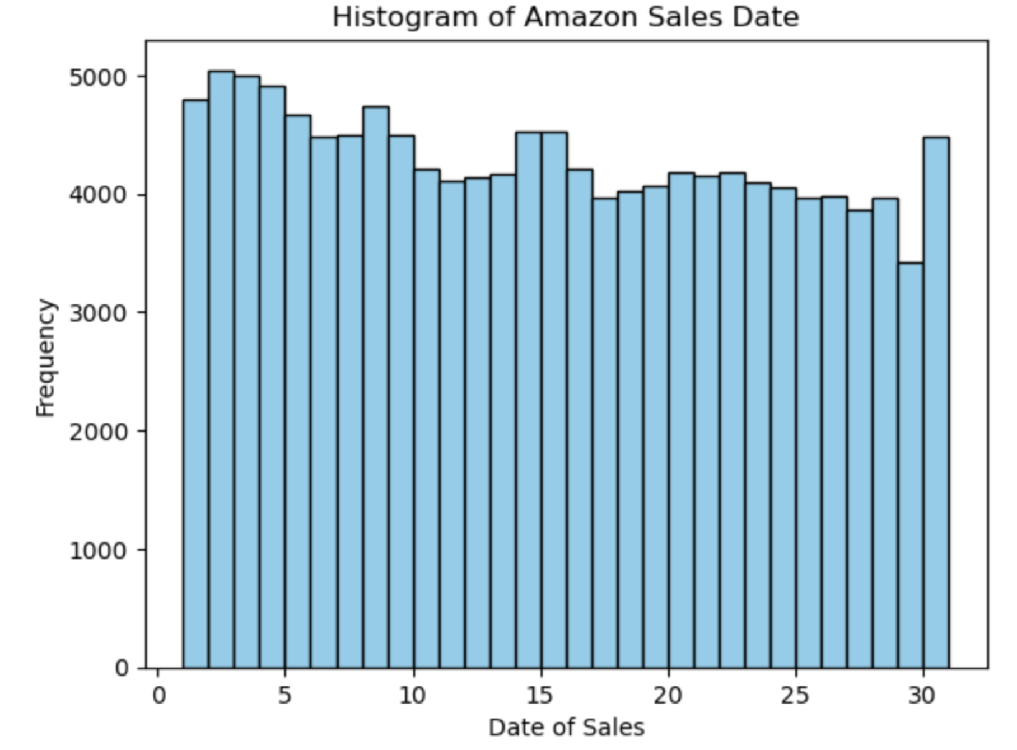
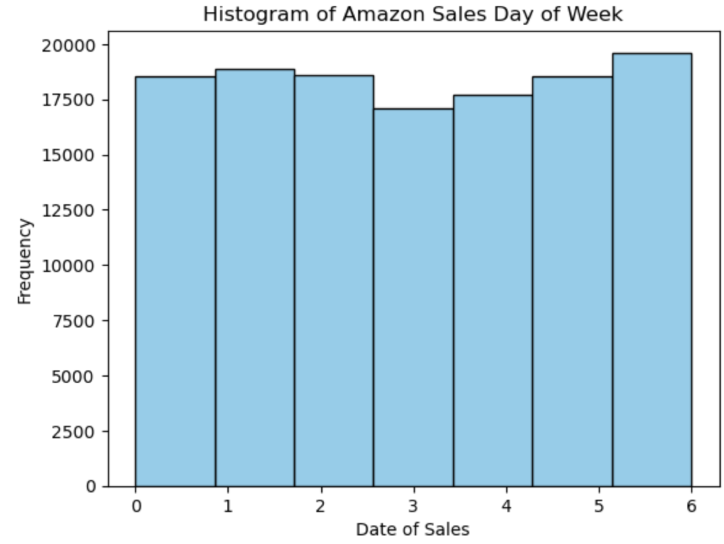
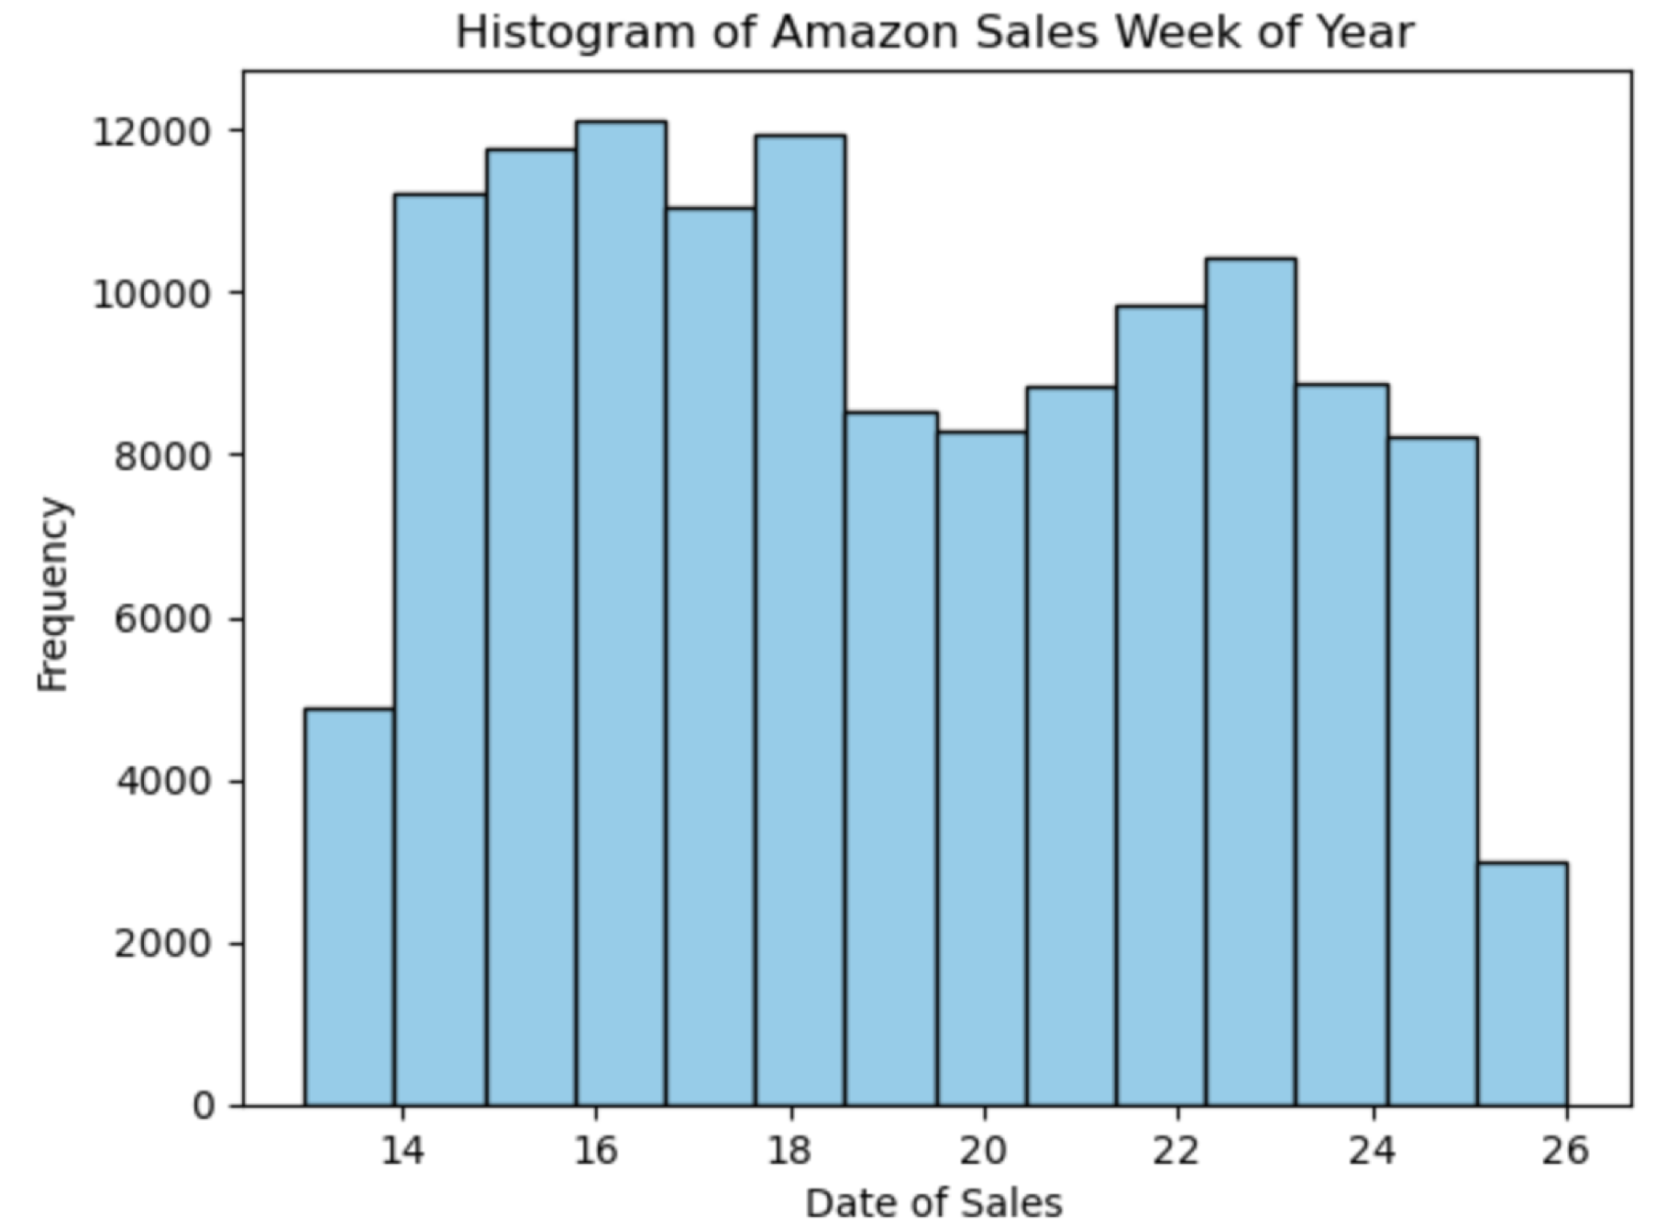
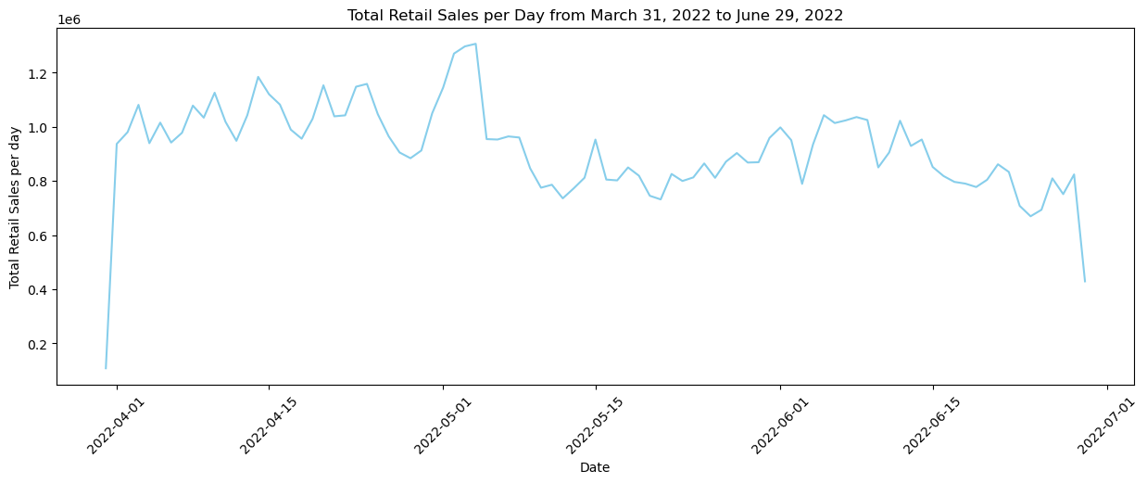
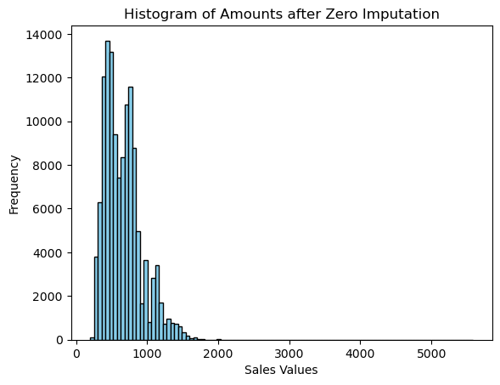
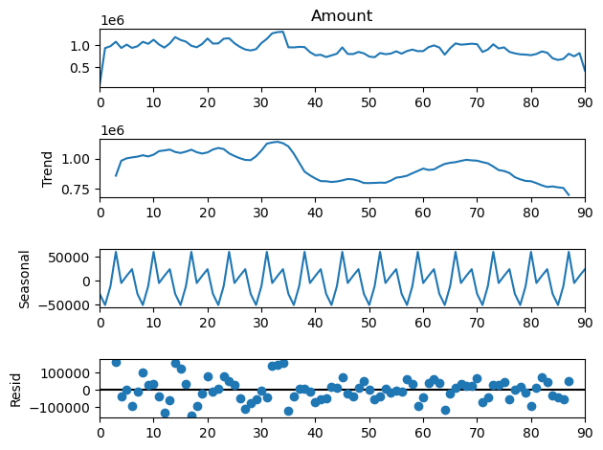
The Data
FEATURES USED
Date
Month
Day
Day of week
Day of year
Week of year
Amount (target)
CLEANING/ANALYSIS
manage null values
value counts
summary statistics
histograms
outliers/boxplots
scatterplots
correlations
decomposition & Dicky Fuller

Slide 4
Models
Auto ARIMA
Strengths: Weaknesses:
+ Flexible - Multivariate
XGBoost Regression
Strengths: Weaknesses:
Random Forest Regression
Strengths: Weaknesses:
+ Easy implementation & interpretation - Pre-processing & tuning
+ Reliable forecasting & confidence intervals
+ High Accuracy - Complex data
+ Fast learning
+ Easy Tuning
+ Variable Ranking
+ Resistant to noise - Computational complexity
+ Manges high dimensional datasets - Interpretability
+ Feature relevance - Overfitting
+ Non-Parametric Nature
+ Handles missing values & outliers
+ Handles numerical & categorical data
Linear Regression
Strengths: Weaknesses:
+ Linear data - Prone to underfitting
+ Simple Implementation - Sensitive to outliers
+ Overfitting reduced by regularization - Assumes independence

Slide 5
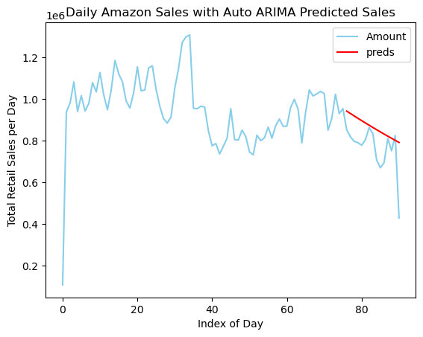
Model Evaluation
Model | Root Mean Squared Error | Weighted Mean Absolute % Error
Auto ARIMA | 135,386 | 14.0%
Linear Regression | 126,488 | 22.4%
XGBoost Regression | 207,064 | 22.7%
Random Forest Regression | 211,753 | 24.3%

Slide 6
ASSUMPTIONS
Stationarity and Invertibility
Imputation of 0 Amounts with category mean
LIMITATIONS
Only one quarter of data
CHALLENGES/ISSUES
Ten features with null values
Susceptible to outliers and anomalies
No negative sale amounts for cancellations

Slide 7
Ethical Assessment
Decision making based on estimated forecasting that has not happened yet.
It is essential data science initiatives are not intentionally or unintentionally be steered by political views.

Slide 8
THANK YOU!
REFERENCES
Anil. (2022). E-Commerce Sales Dataset. Kaggle. https://www.kaggle.com/datasets/thedevastator/unlock-profits-with-e-commerce-sales-data
Bosze, A. (n.d.). What is an eCommerce Sales Forecast? (+ 3 Ways to Calculate It). DOOFINDER. https://www.doofinder.com/en/blog/sales-forecast-e-commerce
Nau, Robert. (n.d.). Statistical forecasting: notes on regression and time series. Fuqua School of Business, Duke University. https://people.duke.edu/~rnau/ethics.htm
Nielson, Aileen. (n.d.). Practical Time Series Analysis. O’Reilly. https://www.oreilly.com/library/view/practical-time-series/9781492041641/ch01.html
Peixeiro, Marco. (2023). The Complete Guide to Time Series Models. Builtin. https://builtin.com/data-science/time-series-model
Tamplin, True. (2023). Autoregressive Integrated Moving Average (ARIMA). Finance Strategists. https://www.financestrategists.com/wealth-management/fundamental-vs-technical-analysis/autoregressive-integrated-moving-average-arima/

